Slide 1

INFO5990
Professional Practice in IT
School of Information Technologies
University of Sydney
Lecture 2: Sourcing, managing and nurturing human resources in IT & Change Management

Slide 2
Agenda
Talent Terminology
Sourcing & Managing IT Talent
Key Challenges
Nurturing and Retaining IT Talent
Your Career Development
Change management & HR relationship
Telecoms Case Study from Telstra

Slide 3
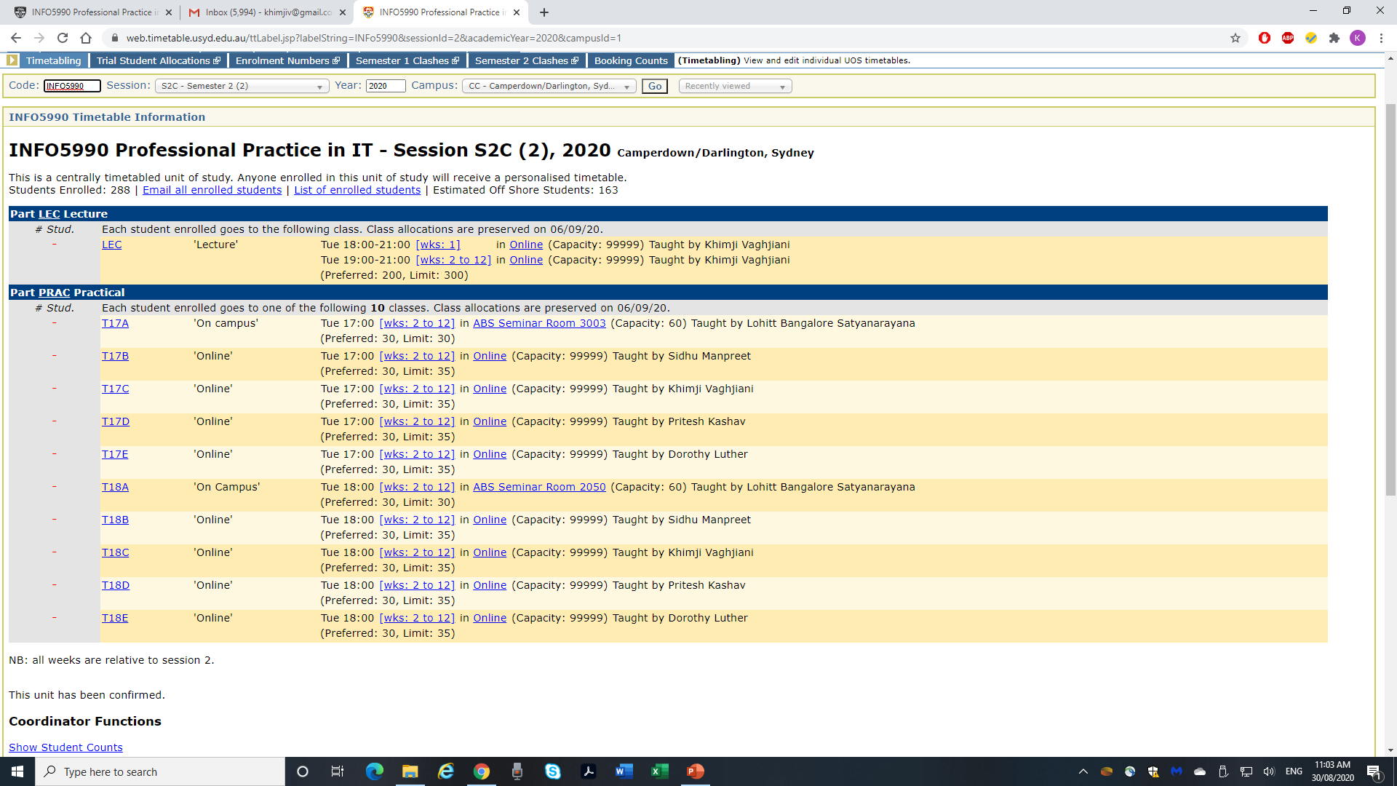

Slide 4
Confirm the Terminology
IT Human Resources
“HR” Departments
IT Talent
“Talent and Capability” Departments

Slide 5

Sourcing IT Talent
How do organisations recruit IT Talent?

Slide 6

Sourcing IT Talent
Options include:
Hire a recruitment company to source IT candidates
Direct recruitment
Permanent job offers
Contract staff
Outsource / local and international
LinkedIn – my own example- QSTP
Any others?
Source:Pageuppeople

Slide 7


Examples

Slide 8

Key Challenges
What are
the key challenges of sourcing talent?

Slide 9


Differentiation
source:mscareergirl.com
source:partnersinexellenceblog.com

Slide 10
Key Challenges
Challenges when recruiting | Steps to overcome them
Pace of change in the industry means skills can become out of date, Recruiter is not technically aware
Techos need to know how business works
Lower cost global options
Skill shortage (eg with emerging technologies)

Slide 11
Managing IT Talent
Top strategies for managing IT Talent are:
Performance Management
If you do well do are offered more training for wider experience
Leadership Development
If you do well you are given additional and more senior training

Slide 12
Nurturing and Retaining IT Talent
The Deloitte and CIO survey showed that the top 3 attraction and retention strategies are:
Differentiate compensation based on performance
Provide access to coaching and mentoring
Offer job and career flexibility

Slide 13
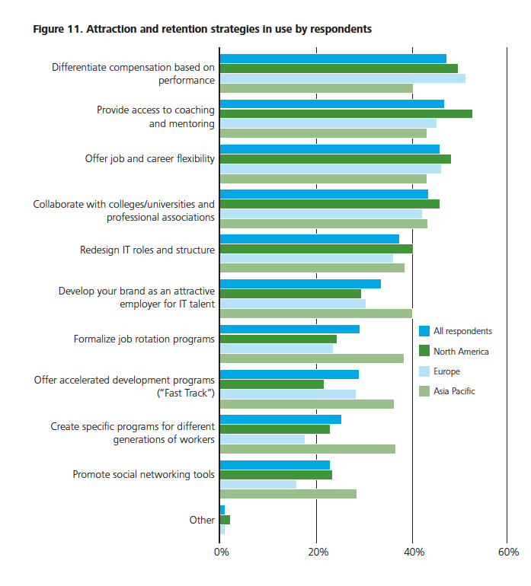
What are your top 3?
Source http://www.cio.com/documents/whitepapers/mindthetalentgap.pdf

Slide 14

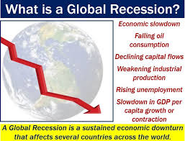
Managing Talent in a recovery
Deloitte outlined the following steps to managing IT Talent in a Recovery:
Communicate and show you care
Managers to be accountable
Clear Career Path
Don’t burn
Try to avoid pay cuts
Smarter ways to develop people
Tell the truth
When does these steps need to be taken?
Source: elementus.io
Source: Market business review

Slide 15
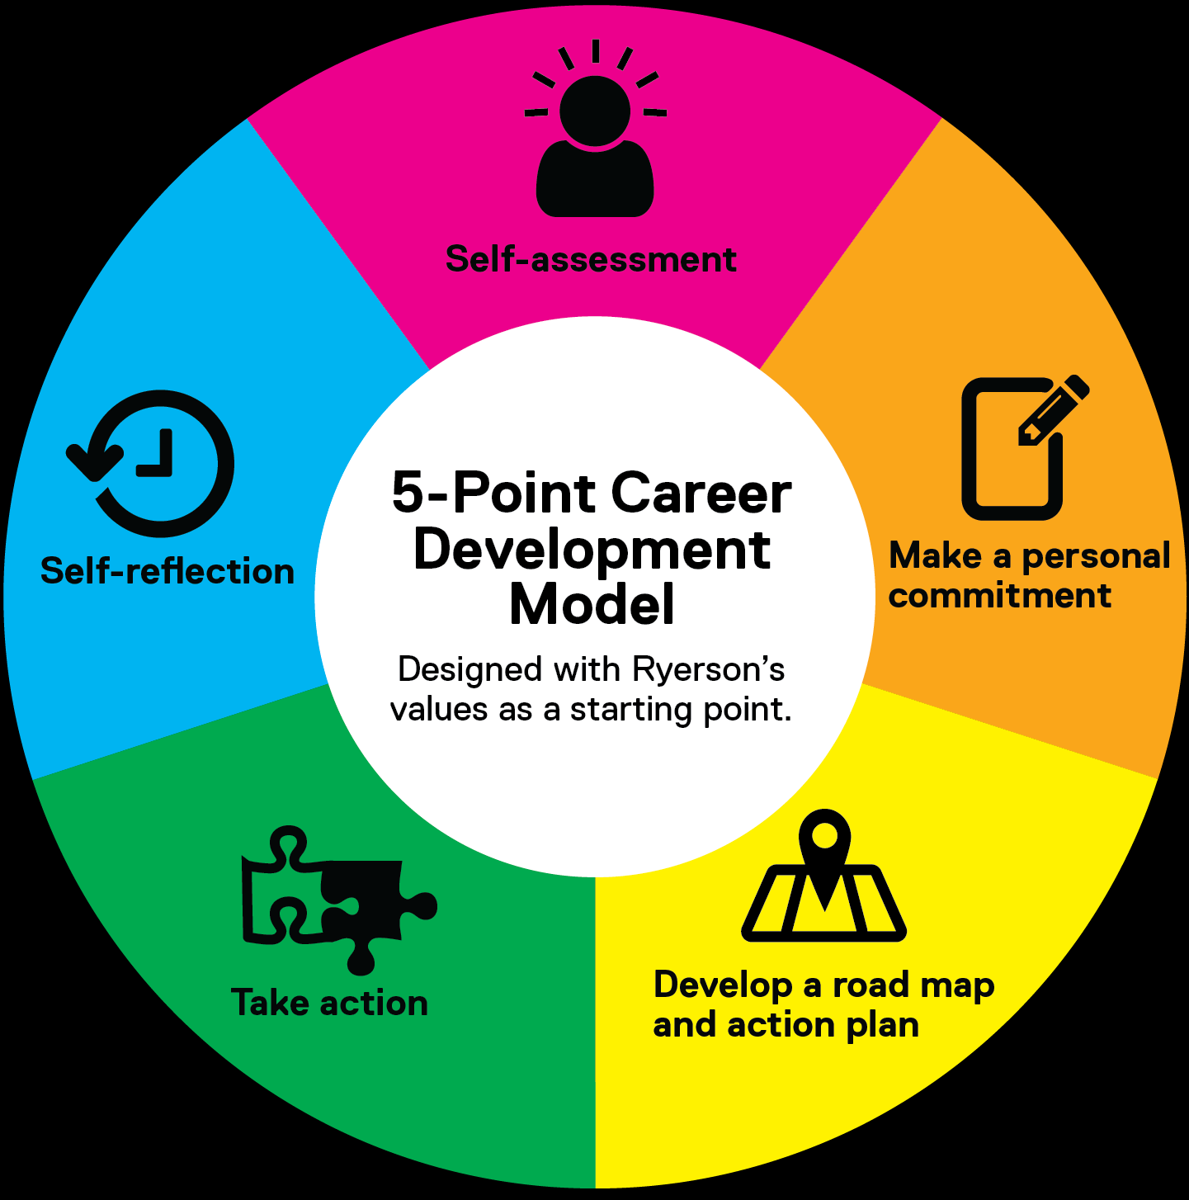
Your Career Development
How many hours have you spent planning your career over the last 12 months?
Source : Ryerson University
Do you know what you want to do in 2 years? 5 years?
Look at your strengths and weakness area’s !

Slide 16
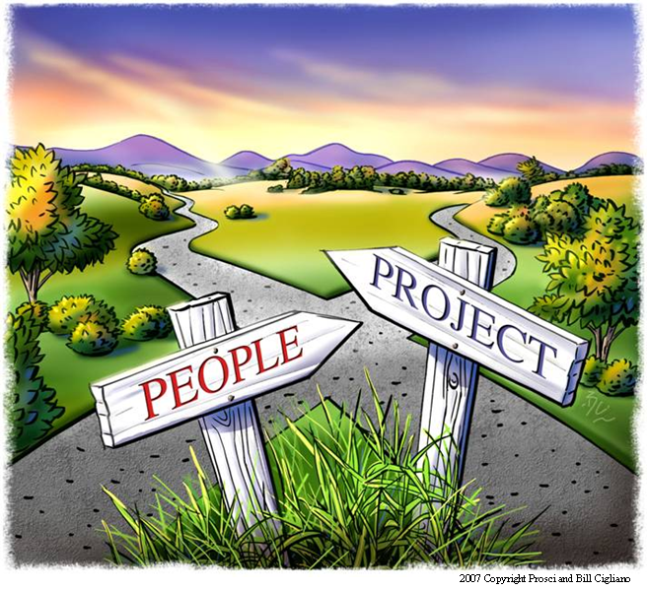
Why Change Management?
It’s the “people side” of projects important to IT Talent retention and attrition ?
Notes:
ASK: What does this picture say to you?
At some point, the implementation side of change, the project, intersects with the people side of change, organisational change management
Run the risk of going in different directions and never meeting up, so the full benefits of the project are never realised
If you plan for it, you can actually be ready at the intersection to point to guide them both in the same direction
Run though example of the Cross City Tunnel in Sydney – brilliant piece of technical project delivery but the people were not engaged properly (if at all). Result – the financial benefits originally promised fell woefully short and the entire investment had a massive write down and was eventually sold. Not a good stakeholder or investor outcome. Good example where if proper change management was involved, the outcome would have been very different

Slide 17
What is Change Management?
On a project level:
“Change management is a structured process and set of tools for leading the people side of change to achieve a desired outcome.”
Prosci 2002
A leadership competency for enabling change within an organisation.
A strategic capability designed to increase change capacity and responsiveness.
Change Management for IT vs.
Change Management for People
This is Organisational Change Management (or OCM)
On an organisational level:

Slide 18
Reasons for applying OCM?
The number one obstacle to success for major change projects is:
employee resistance and the ineffective management of the people side of change
Impacts of NOT doing change management
OCM
Organisational Change Management
Notes:
Unless you bring impacted employees along with you on the change journey, the resistance you are likely to encounter will spell doom for the financial outcomes you are trying to deliver.
Sometimes, that means being aware of when people are undergoing “change saturation” or “change fatigue”.
There is just too much going on for them to process and deal with what management is asking them to do.

Slide 19
The difference between project management and change management
Focus:
Technical side of moving from current state to future state
Solution is designed, developed and delivered effectively (Technical side)
Project Management
Current
Transition
Future
+
Solution is embraced, adopted and utilised effectively (People side)
Change Management
Focus:
People side of moving from current state to future state
= SUCCESS
Complimentary disciplines with a common objective
Notes:
Remember the cross city tunnel example – technical solution was near perfect but the people side was woefully lacking. Result – was a thoroughly UNSUCCESSFUL outcome.

Slide 20

Change is a process…
Where you are today
Where you want to be
Employees are comfortable with and prefer the current state
The future state is unknown or not well understood
Current
state
Transition
state
Future
state
The transition state creates stress and anxiety

Slide 21
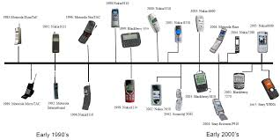
States of change
Utilising an organisational perspective…
Current
Transition
Future
Ad hoc processes
Documented and managed processes
Old operating model
New operating model
Generalists in the call centre
Specialists in the call centre
No web interface for suppliers
Supplier website integrated into supply chain
Two different companies
Merged organisation

Slide 22
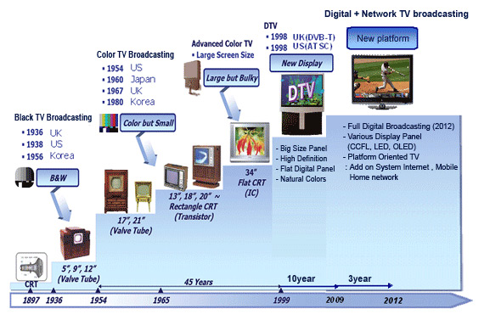
Another example
Source:techgeez.com

Slide 23
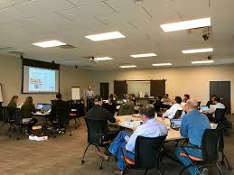
Why you should care?
As IT Professionals, your work has implications and impacts beyond your immediate team
By understanding your customers better and the impacts they face, you will deliver better quality solutions. More skills = more value = more marketability
Evolution of IT from an ‘order taker’ to a strategic partner of the business

Slide 24

Who ‘does’ change management?
Executives & Senior Managers
Mid-Level Managers & Supervisors
Each ‘gear’ plays a specific role based on how they are related to organisational change
Change Management resources
Project team
Project support functions

Slide 25
Key roles in Change Management
Employee-facing:
Executives and senior leaders – fulfilling the role of sponsors of change
Middle managers and supervisors – fulfilling the role of coach for their direct reports
Enabling:
Change management resource or team – applying a structured approach and enabling others
Project team – integrating the “people side” of change
Support functions – providing expertise
Executives & Senior Managers
Mid-Level Managers & Supervisors
Change Management resources
Project team
Project support functions

Slide 26



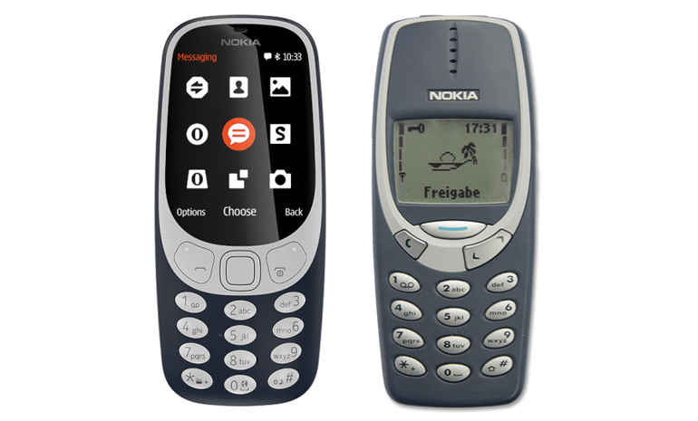

Any examples of Change Management In organisations?
What has the impact been ?
Source: Chicago Tribune
Source: ZdNet
2002 2018 1920 2018

Slide 27
“Why” change management?
Three perspectives to think about…
1. Connecting change management to business results
2. Mitigating negative consequences
3. Translating change management to financial performance

Slide 28
Connecting OCM to business results
Project Name
(what is the project?)
Purpose
(why are we changing?)
Particulars
(what are we changing?)
People
(who will be changing?)
If people don’t change how they do their job, then it doesn’t matter what specific changes are implemented
If people don’t change how they do their job, then we ultimately won’t achieve what we set out to from the beginning

Slide 29
Mitigating negative consequences
With poorly managed change, you can expect a bigger impact that will last longer
The reality is that change creates instability and introduces risk to the organisation. Multiple changes within the organisation aggravate and compound this risk
The degree of impact will vary by group and depends on the effectiveness of OCM work
With change, you can expect a decline in productivity and an increase in resistance

Slide 30
Translating OCM to financial performance – human ROI factors
This ”Flight Risk Model” reveals the cost avoidance of OCM:
Productivity loss
Turnover
Customer Impact
What about the ROI (return on investment) of managing the people side of change?
Speed of adoption
How quickly are people up and running on the new systems, processes and job roles?
Ultimate utilisation
Of the total population, how many employees are demonstrating “buy-in” and are using the new solution?
Proficiency
Are individuals performing at the level expected in the design of the change?

Slide 31
Expected returns vs. poorly managed OCM
+
Go-live
Net cash flow of project period
0
Time (periods)
-
Expected cash flow (what the business case says)
Poorly managed change cash flow (what actually happens)

Slide 32

The ADKAR® Change Model
The five building blocks for successful change
Awareness
Desire
Knowledge
Ability
Reinforcement
Of the need to change
Of the nature of the change
To support the change
To participate and engage
On how to change
On how to implement new skills and behaviors
To implement the change
To demonstrate performance
To sustain the change
To build a culture and competence around change

Slide 33
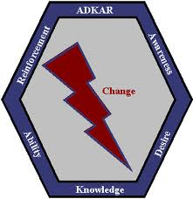
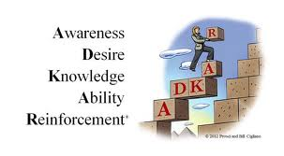
Your change journey…
Think about a recent change you have been involved with
Can be personal or business related
Was it a favorable experience (or not) as a result?

Slide 34



The Psychology of Change
Theories and perspectives
Change agents must be conscious of both a senders’ mentality and the receivers’ orientation.
Employee resistance is the norm, not the exception. Expect some to never support the change.
Visible and active sponsorship is not only desirable but necessary for success.
Value systems have a direct impact on how employees react to change.
The size of the change determines how much and what kind of change management is needed.
The “right” answer is not enough to successfully implement change.
Employees go through the change process in stages and go through these stages as individuals.

Slide 35
Not everyone changes at the same pace
Person A
A
D
K
A
R
Person B
A
D
K
A
R
Person C
A
D
K
A
R
Person D
A
D
K
A
R
Person E
A
D
K
A
R
Person F
A
D
K
A
R

Slide 36
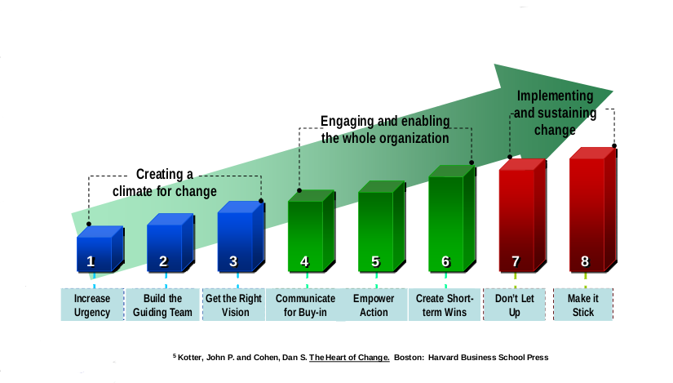
John Kotter’s 8 Step Change Model

Slide 37


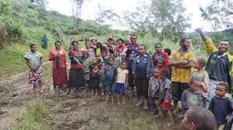
Case Study- Telecoms
Fixed Radio Access Project and change What happened ?

Slide 38
For next week
Remember !!
You should now be in teams
Start thinking about your group topic
Check with your tutor – no duplicates in class
Do the readings
Start working on your group assignment
Notes:
Need to highlight that this theory is specifically centered on small groups.

Slide 39

Q&A
Notes:
Need to highlight that this theory is specifically centered on small groups.

